Slide 1
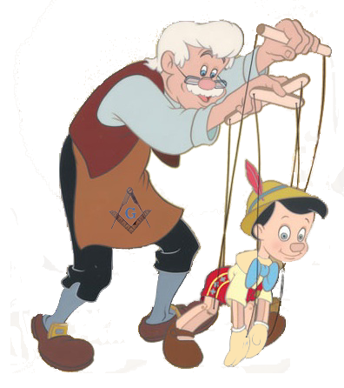
Geppetto A Language for Modeling the Behavior of Intelligent Agents
By Paul Holmes and Mitchell Aharon

Slide 2

Motivation
Exploring the link between biological intelligence and artificial intelligence

Slide 3
Program Structure
Declarations
Property state(string s {“hunting", “eating"});
entity fox {state (s=“hunting”)};
Rules
fox.state == “hunting” -> printStatus();
Code
int printStatus() { print “Fox is “ + fox.state); return 0; }

Slide 4
Language Architecture
Entities

Slide 5
Language Architecture
Entities
States

Slide 6
Language Architecture
Entities
States
Rules

Slide 7
Package Hierarchy
Geppetto
Domain
Declaration
Expression
Parser
Statement

Slide 8
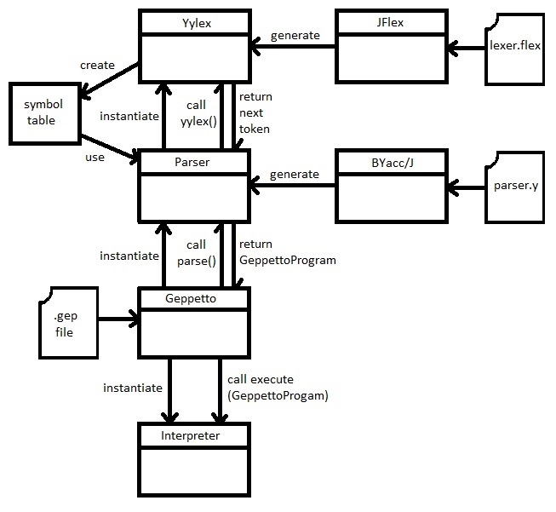
Translator Architecture

Slide 9
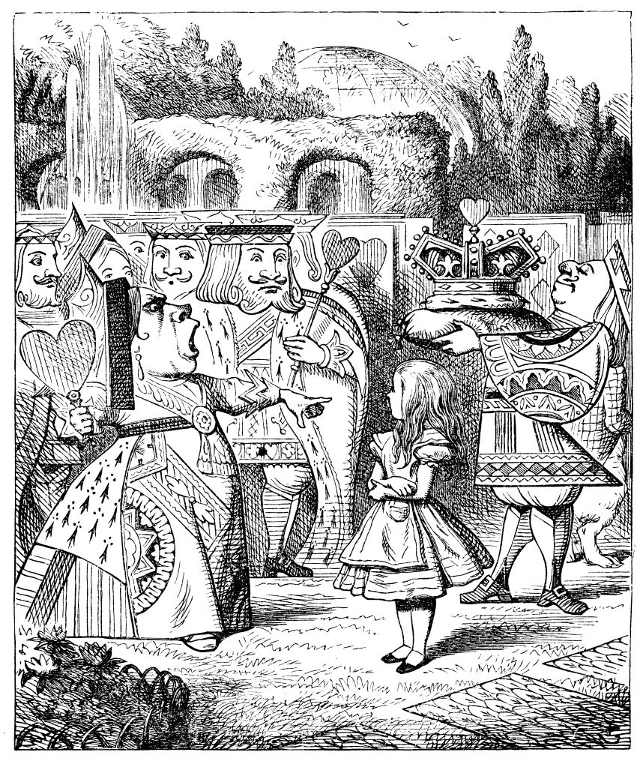

Project Management
“Nothing is particularly hard if you divide it into small parts.” – Henry Ford
“Begin at the beginning, and go on till you come to the end: then stop” – Lewis Carroll, Alice’s Adventures in Wonderland

Slide 10





Tools

Slide 11
Runtime Environment
Geppetto interpreter is a Java program
Executed just like any Java program:
java –jar geppetto.jar myprogram.gep

Slide 12

Test Plan
Mostly trial and error
Used toString() to dump contents of AST to console
Added syntax to .gep files for testing as they were coded

Slide 13
Project Demo
Predator-Prey Simulation
Featuring Fox & Rabbit

Slide 14
Anatomy of a Geppetto File
property type(string s {"predator", "prey"});
property state(string s {"foraging", "hunting", "relaxing", "fleeing", "dead"});
property pos(int x{1-10}, int y{1-10});
entity fox {type(s="predator"), state(s="hunting"), pos(x=7, y=5)};
entity rabbit {type(s="prey"), state(s="foraging"), pos(x=1, y=1)};
rule (true) -> printStatus();
rule sameLocation (fox.state.s == "hunting" && fox.pos.x == rabbit.pos.x && fox.pos.y == rabbit.pos.y) -> eat();
rule differentLocation (fox.state.s == "hunting" && (fox.pos.x != rabbit.pos.x || fox.pos.y != rabbit.pos.y)) -> approach();
int printStatus() {
print("fox: state: " + fox.state.s + ", x=" + fox.pos.x + ", y=" + fox.pos.y);
print("rabbit: state: " + rabbit.state.s + ", x=" + rabbit.pos.x + ", y=" + rabbit.pos.y);
return 0;
}
int eat() {
print("Gotcha! on cycle " + cycle);
fox.state.s = "relaxing";
rabbit.state.s = "dead";
printStatus();
end;
}
int approach() {
print("Moving toward prey...");
if (fox.pos.x > rabbit.pos.x)
fox.pos.x = fox.pos.x - 1;
if (fox.pos.x < rabbit.pos.x)
fox.pos.x = fox.pox.x + 1;
if (fox.pos.y > rabbit.pos.y)
fox.pos.y = fox.pos.y - 1;
if (fox.pos.y < rabbit.pos.y)
fox.pos.y = fox.pos.y + 1;
return 0;
}

Slide 15
Properties
property type(string s {"predator", "prey"});
property state(string s {"foraging", "hunting", "relaxing", "fleeing", "dead"});
property pos(int x{1-10}, int y{1-10});

Slide 16
Entities
entity fox {type(s="predator"), state(s="hunting"), pos(x=7, y=5)};
entity rabbit {type(s="prey"), state(s="foraging"), pos(x=1, y=1)};

Slide 17
Rules
rule (true) -> printStatus();
rule sameLocation (fox.state.s == "hunting" && fox.pos.x == rabbit.pos.x && fox.pos.y == rabbit.pos.y) -> eat();
rule differentLocation (fox.state.s == "hunting" && (fox.pos.x != rabbit.pos.x || fox.pos.y != rabbit.pos.y)) -> approach();

Slide 18
Code
int printStatus() {
print("fox: state: " + fox.state.s + ", x=" + fox.pos.x + ", y=" + fox.pos.y);
print("rabbit: state: " + rabbit.state.s + ", x=" + rabbit.pos.x + ", y=" + rabbit.pos.y);
return 0;
}
int eat() {
print("Gotcha! on cycle " + cycle);
fox.state.s = "relaxing";
rabbit.state.s = "dead";
printStatus();
end;
}
int approach() {
print("Moving toward prey...");
if (fox.pos.x > rabbit.pos.x)
fox.pos.x = fox.pos.x - 1;
if (fox.pos.x < rabbit.pos.x)
fox.pos.x = fox.pox.x + 1;
if (fox.pos.y > rabbit.pos.y)
fox.pos.y = fox.pos.y - 1;
if (fox.pos.y < rabbit.pos.y)
fox.pos.y = fox.pos.y + 1;
return 0;
}

Slide 19
Output
Running program...
fox: state: hunting, x=7, y=5
rabbit: state: foraging, x=1, y=1
Moving toward prey...
fox: state: hunting, x=6, y=4
rabbit: state: foraging, x=1, y=1
Moving toward prey...
fox: state: hunting, x=5, y=3
rabbit: state: foraging, x=1, y=1
Moving toward prey...
fox: state: hunting, x=4, y=2
rabbit: state: foraging, x=1, y=1
Moving toward prey...
fox: state: hunting, x=3, y=1
rabbit: state: foraging, x=1, y=1
Moving toward prey...
fox: state: hunting, x=2, y=1
rabbit: state: foraging, x=1, y=1
Moving toward prey...
fox: state: hunting, x=1, y=1
rabbit: state: foraging, x=1, y=1
Gotcha!
fox: state: relaxing, x=1, y=1
rabbit: state: dead, x=1, y=1
End statement encountered. Terminating program.
Program execution complete.

Slide 20
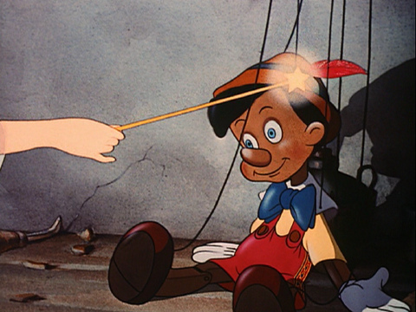

Geppetto’s Purpose

Slide 21

…though hopefully it won’t come to this…

